Slide 1
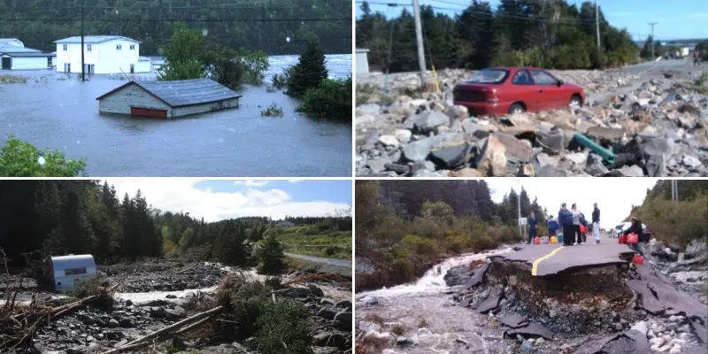

Characteristics of a Novel Sampling for Future Extremes
https://vocm.com/2019/09/21/17211/
Pauline Rivoire^{1,2}, Tatjana Milojevic¹, Michael Lehning^{1,3}
¹Laboratory of Cryospheric Sciences, School of Architecture, Civil and Environmental Engineering, Ecole Polytechnique Fédérale de Lausanne, Lausanne, Switzerland
² Institute of Earth Surface Dynamics, University of Lausanne, Switzerland
³WSL Institute for Snow and Avalanche Research (SLF), Davos, Switzerland
© Adobe Stock

Slide 2
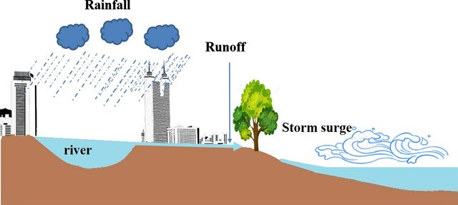
Motivation
Synthetic time series useful, to create more data, with desired characteristics, e.g. as input for hydrological models (Peleg et al. 2017)
Generation can be very computationally expensive (Fatichi et al 2011)
Modeling compound events, the dependance between variables should be accurately represented
Conceptual diagram of compound floods in coastal areas →
(Xu et al., 2023)

Slide 3


Goal
Generate synthetic time series of multiple variables, consistent together
Use what we already have: observations, and mean change according to future projections
Spoiler: cannot go beyond what has been observed, but can still create extreme conditions

Slide 4
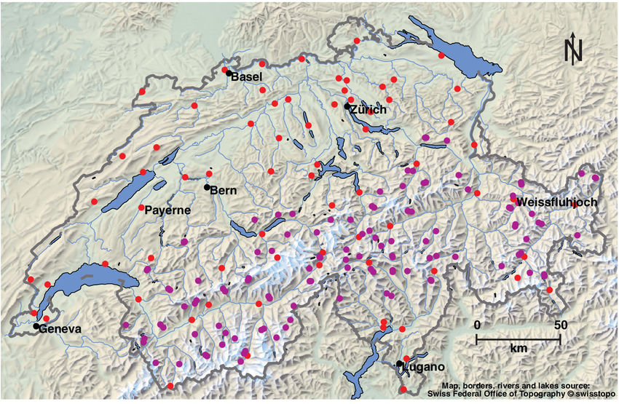
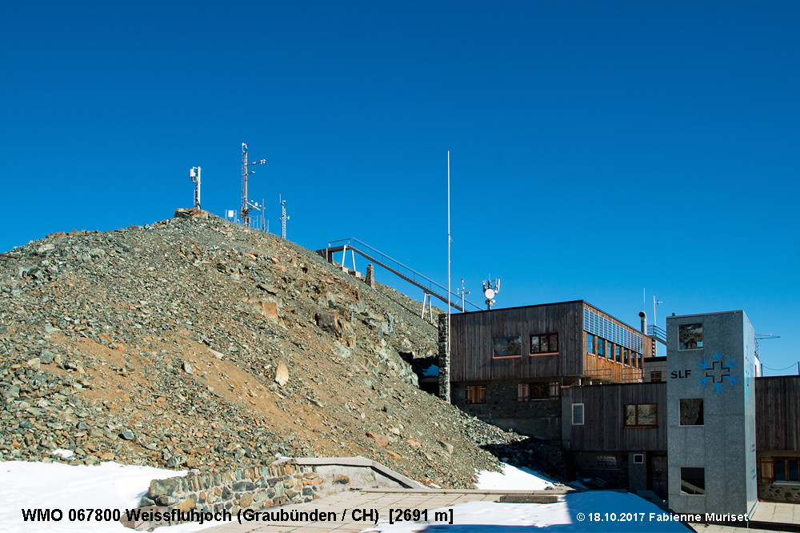
Data: observation
(Michel et al., 2021)
MeteoSwiss station observation
Weissflujoch 1995-2022
temperature, wind speed, precipitation, incoming short-wave radiation and relative humidity
https://www.fotometeo.ch/wetterstationen-niederschlagsradar-und-das-observatorium-davos/
https://www.meteoswiss.admin.ch/weather/measurement-systems/land-based-stations/automatic-measurement-network.html

Slide 5
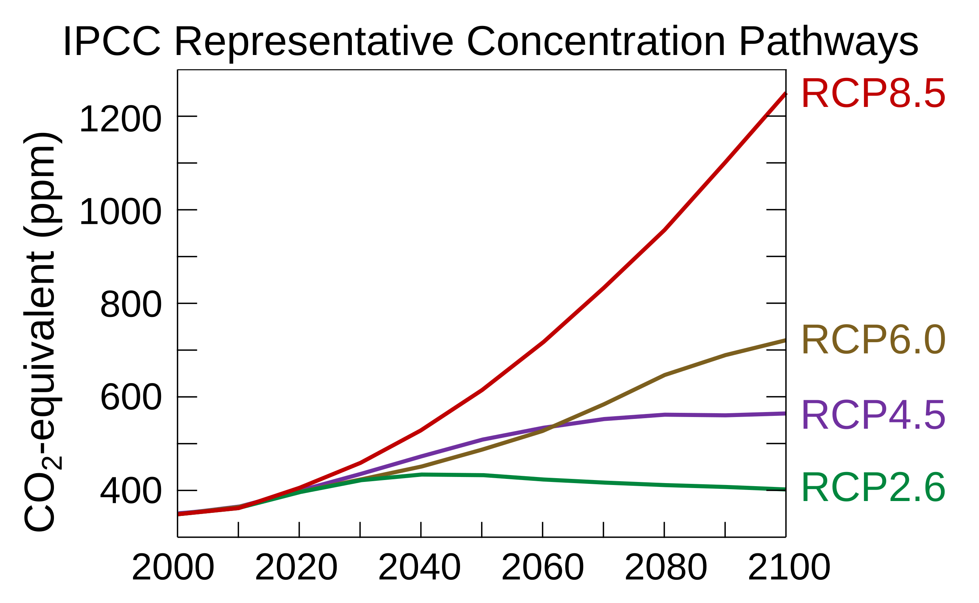
Data: future projection
MeteoSwiss future projection, downscaled to station scale
temperature, wind speed, precipitation, incoming short-wave radiation and relative humidity
Daily data.
For sampling: only use mean information on temperature and precipitation
(Michel et al., 2021)
https://fr.wikipedia.org/wiki/Sc%C3%A9nario_RCP#/media/Fichier:All_forcing_agents_CO2_equivalent_concentration.svg
Notes:
We will use only mean temperature and precipitation (and quantiles), don’t use the daily information first. Just later for comparison

Slide 6


Method
JJA
JJA
JJA
Station observation
t2m,
wind,
precip,
radiation,
rel. humidity
…
Sample blocks of n days
n = 3, 7, 10 days
…
Matches constraints?
Constraints, RCP2.6
T2m: mean +1°C
No
precip:
Dry days +3%
median -0.5mm
Q90 -3mm
Yes
return sample:
JJA
Synthetic time series
…

Slide 7

Constrained variables
7

Slide 8

Constrained variables
8

Slide 9

Constrained variables
9

Slide 10
Constrained variables
10

Slide 11
Obtained time series:
11
50 years of daily data:
temperature, wind speed, precipitation, incoming short-wave radiation and relative humidity
Sampled from observation, but matching RCP2.6 seasonal constraints in temperature and precipitation

Slide 12
Obtained time series: Daily temperature, SON
Notes:
Cannot create beyond observation

Slide 13
Or… can we?
We cannot create information beyond observation

Slide 14
Obtained time series: precipitation quantiles, DJF
(Naveau et al., 2016)
Notes:
Change in distribution
Doesn’t create beyond, but gives the new shape to the tail . Why we do it! (but we are not sure, we try)

Slide 15
Obtained time series:
…
…
…
Notes:
First attempt, fail

Slide 16
…

Slide 17
…

Slide 18
Obtained time series:
Notes:
Depends on the size of the block, on the random seed

Slide 19
Obtained time series:
Notes:
Disclamer: depends on the ensemble member

Slide 20
bivariate extremes
Let’s zoom on

Slide 21
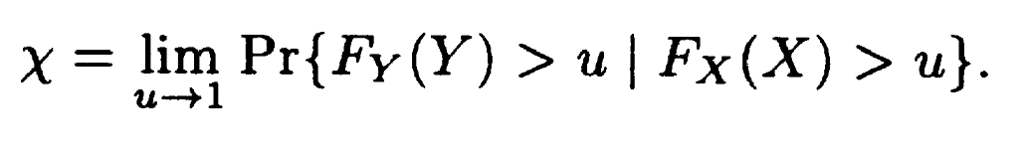
Tail (in)dependance
(Coles et al., 2001)
>0 asymptotic dependence
=0 asymptotic independence
Notes:
3. for asymptotically independent variables, X = 0
4. within the class of asymptotically dependent variables, the value of X increases with strength of dependence at extreme levels.

Slide 22
Tail (in)dependance (wind,precipitation)

Slide 23
Tail (in)dependance (-wind,-radiation)

Slide 24
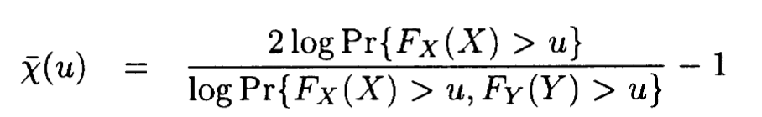
Tail (in)dependance
(Coles et al., 2001)
>0 asymptotic dependence
=0 asymptotic independence
rate at which goes to zero
Notes:
If chi goes to zero: asymptotic independence. But it can be dependent, but chi equal to zero
chiplot {evd}

Slide 25
Tail (in)dependance (-wind,-radiation)

Slide 26

Thank you!
Conclusion
Simple, cheap and flexible method.
Advantage: synthetic time series, but configurations that could happen, because it already did!
No daily data beyond observation but can create extreme conditions.
Limit: discontinuity between blocks
Still refining the method/analysis
… suggestions are welcome ☺

Slide 27
References
Michel, A., Sharma, V., Lehning, M., & Huwald, H. (2021). Climate change scenarios at hourly time‐step over Switzerland from an enhanced temporal downscaling approach. International Journal of Climatology, 41(6), 3503-3522. https://doi.org/10.1002/joc.7032
Xu, K., Wang, C. & Bin, L. Compound flood models in coastal areas: a review of methods and uncertainty analysis. Nat Hazards 116, 469–496 (2023). https://doi.org/10.1007/s11069-022-05683-3
https://www.meteoswiss.admin.ch/weather/measurement-systems/land-based-stations/automatic-measurement-network.html
Philippe Naveau, Raphaël Huser, Pierre Ribereau, Alexis Hannart. Modeling jointly low, moderate, and heavy rainfall intensities without a threshold selection. Water Resources Research, 2016, 52 (4), pp.2753-2769. 10.1002/2015WR018552
Coles, S. G. (2001) An Introduction to Statistical Modelling of Extreme Values, London: Springer–Verlag
Fatichi, S., Ivanov, V. Y., & Caporali, E. (2011). Simulation of future climate scenarios with a weather generator. Advances in Water Resources, 34 (4), 448–467. https://doi.org/10.1016/j.advwatres. 2010.12.013
Peleg, N., S. Fatichi, A. Paschalis, P. Molnar, and P. Burlando (2017), An advanced stochastic weather generator for simulating 2-D high-resolution climate variables, J. Adv. Model. Earth Syst., 9, 1595–1627, doi:10.1002/2016MS000854

Slide 28
Appendix

Slide 29
Obtained time series: Daily windspeed, SON

Slide 30
Obtained time series: Inc. SW. radiation, SON

Slide 31
Obtained time series: precipitation quantiles, JJA

Slide 32
Remarks
Typical meteorological years: find and create one year that has the same statistics as the climatology. A bit of sampling, but modified. And univariate. (Used for renewable energy)

